Slide 1
XCP Issue Fix

Slide 2
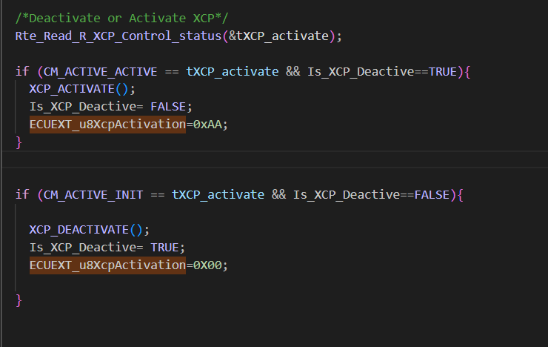
XCP Deactivation
XCP is deactivated by default
XCP access is deactivated from ECUEXT_vMain

Slide 3
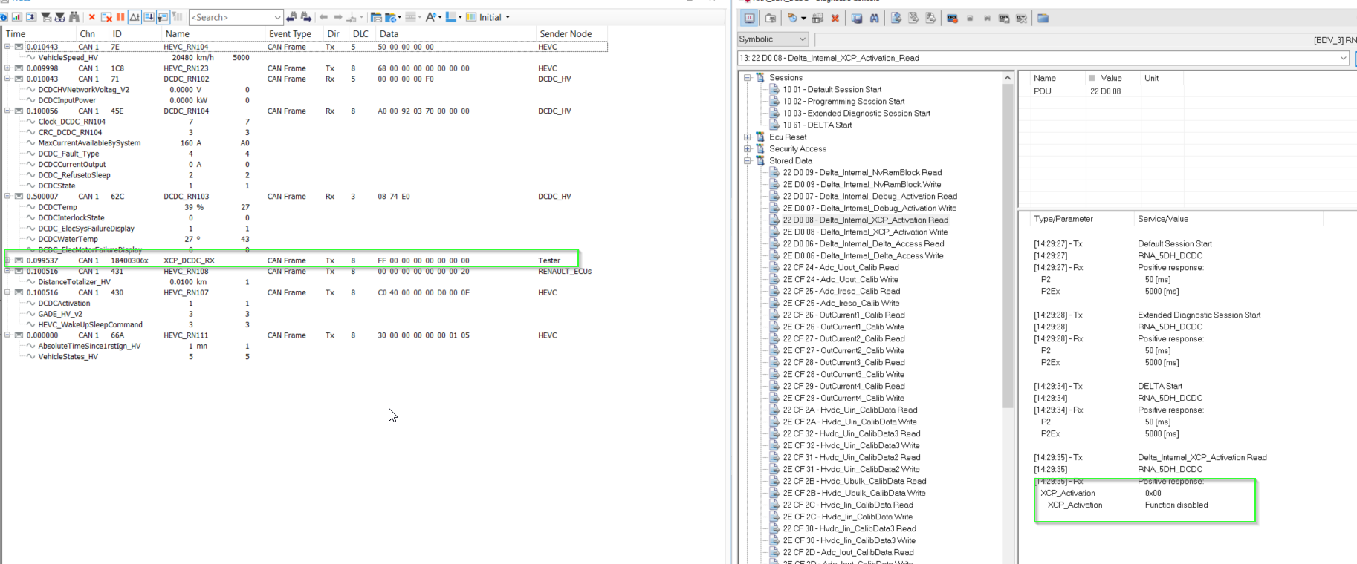

Slide 4
To Activate XCP
DID D008 Delta_Internal_XCP_Activation Write
This DID is available only in Delta Session(Protected by Secure Access)
To Enable XCP : Write 0xAA( Function Enabled ) using 0x2E service
XCP status can be Read using DID D008 Delta_Internal_XCP_Activation
Read
Read the XCP status using 0x22 Service
0xAA - Function Enabled
0x00 - Function Disabled

Slide 5
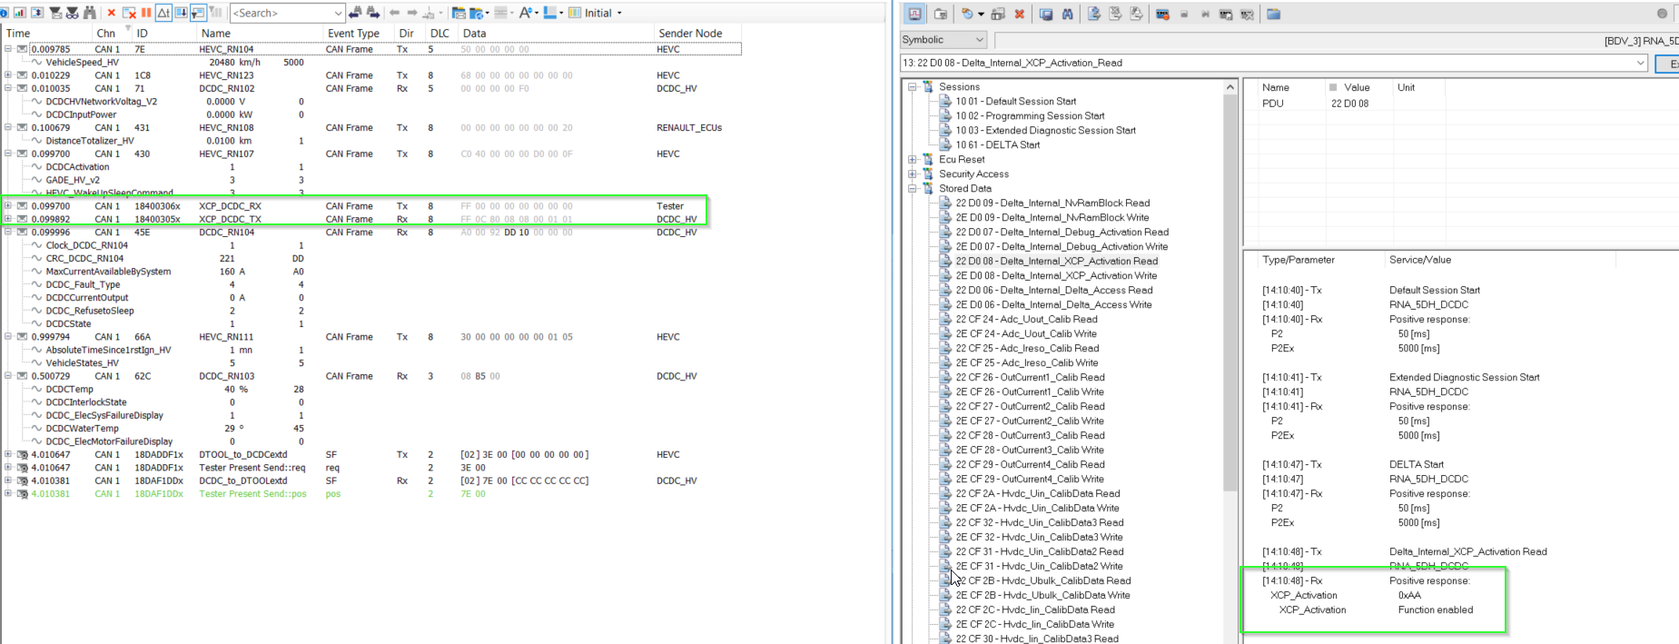

Slide 6
Need Testing on how long before calling the XCP_Deactivate() , the XCP is active
Basic Developmental Test Done
Testing from the QTS required to fully verify

Slide 7
Smarter. Greener. Together.

